Slide 1
Challenges of Normal Conducting RF cavities for a Muon Collider
Derun Li
On behalf of the US Muon Accelerator Program (MAP)
Center for Beam Physics
Lawrence Berkeley National Laboratory
Advanced Accelerator Concepts Workshop
Austin, Texas, June 11, 2012
Office of Science

Slide 2
Outline
Energy Frontier:
Introduction
Lepton Collider options
Muon Collider/Neutrino Factory
R&D toward a muon collider
Muon ionization cooling
US MAP R&D programs
Normal conducting RF cavities R&D for muon ionization cooling
Vacuum normal conducting RF cavities
High pressure NCRF cavities (K. Yonehara’s talk on Thursday)
Status and plans
International MICE and US responsibilities
Summary

Slide 3
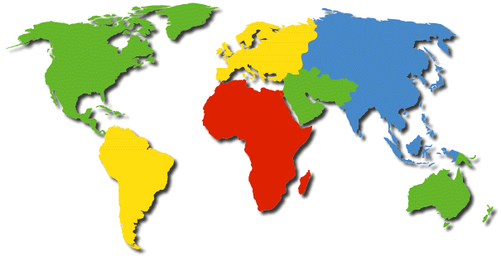
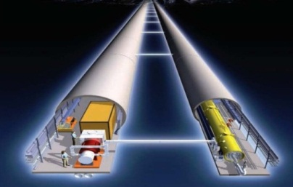
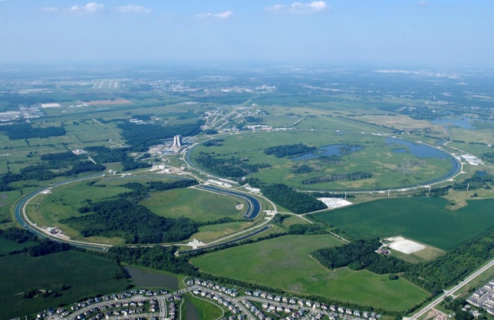
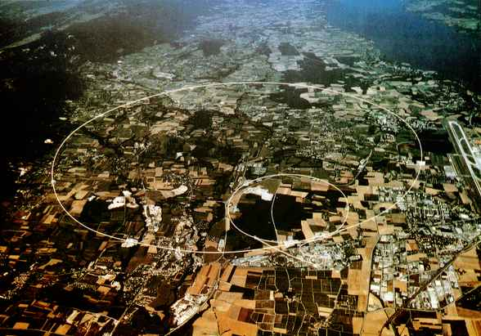
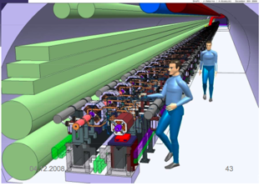
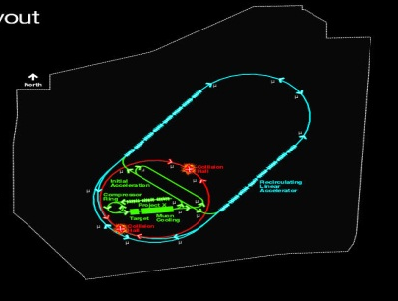
The Energy Frontier
Fermilab
CERN
Tevatron
LHC
Lepton Collider
Physics case,
Energy scale
(Technology, site to be determined)

Slide 4
Three Lepton Collider Options
ILC: 0.5-1.0 TeV e⁺e⁻ linear collider
Superconducting RF accelerating cavities
Technology demonstrated, ready to propose ∼ 2012
Physics/Detectors well studied, R&D ready ∼ 2012
CLIC: 3 TeV e⁺e⁻ linear collider
Two beam acceleration with warm RF
R&D underway, but technical demonstrations needed
Machine and Detector CDR in 2011, TDR in 2018-20?
Muon collider: 3 TeV µ⁺µ⁻ storage ring
US Muon Accelerator Program & International Neutrino factory collaboration will address some of the basic unanswered R&D questions
Feasibility and conceptual design ∼ 2016-17
Possible technical design and demonstrations in 2020’s

Slide 5
Lepton Collider
LHC discoveries would establish energy scale and physics case for a Lepton Collider as the next energy frontier machine
Lepton Collider is a precision instrument that would let us understand Tera-scale physics
Why a Muon Collider?
The same physics reach as a proton collider of ten times higher energy
Strongly coupled to Higgs than electrons
Low synchrotron radiation in a high energy circular machine
Multi-pass acceleration
Multi-pass collisions in ring
Possible to fit a Multi-TeV Collider at Fermilab

Slide 6
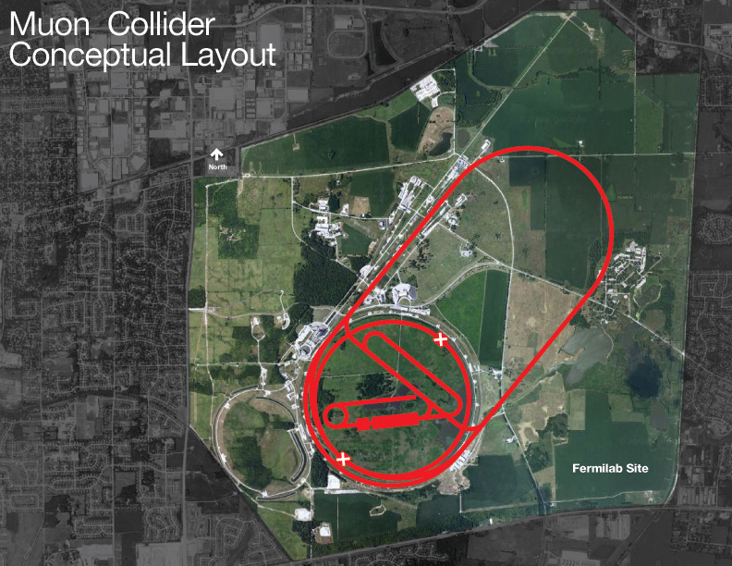
Project X
Accelerate Hydrogen ions to 8 GeV
using SRF technology.
Compressor Ring
Reduce size of beam (2±1 ns).
Target
Collisions lead to muons with energy
of about 200 MeV.
Muon Capture and Cooling
Capture, bunch and cool muons to
create a tight beam.
Initial Acceleration
In a dozen turns, accelerate muons
to 20 GeV
Recirculating Linear Accelerator
In a number of turns, accelerate
muons up to Multi-TeV using SRF
techlnology.
Collider Ring
Bring positive and negative muons
into collision at two locations 100
meters underground.

Slide 7
Challenges of Muon Beams
Muons created as tertiary beam (p → π → μ)
low production rate
need target that can tolerate multi-MW beam
large energy spread and transverse phase space
need solenoidal focusing for the low energy portions of the facility
solenoids focus in both planes simultaneously
need emittance cooling
high-acceptance acceleration system and decay ring
Muons have short lifetime (2.2 μs at rest)
puts premium on rapid beam manipulations
high-gradient RF cavities (in magnetic field) for cooling
presently untested ionization cooling technique
fast acceleration system
Decay electrons give rise to heat load in magnets and backgrounds in collider detector
Target R&D
6-D Cooling
& Accelerator
Physics of
intense Muons
NC high gradient
NCRF cavities in B

Slide 8
R&D Toward a Muon Collider/NF
Neutrino Factory
Muon Collider
Project X
Muon Cooling

Slide 9
R&D Overview of US MAP
US MAP R&D programs:
Simulation and theory effort
Support both Neutrino Factory and Muon Collider design
NF work presently done under aegis of IDS-NF
Development of high-power target technology (Targetry)
Development of cooling channel components (MuCool)
Participate in system tests as an international partner
MERIT (high-power Hg-jet target) [completed]
MICE (ionization cooling demonstration)
EMMA (non-scaling FFAG electron model)
would validate potentially more cost-effective acceleration system
Hardware development and system tests are major focus
Simulation effort has led to cost-effective Neutrino Factory design
and progress toward a complete Muon Collider scenario
just as for NF, simulations will guide hardware and system tests

Slide 10
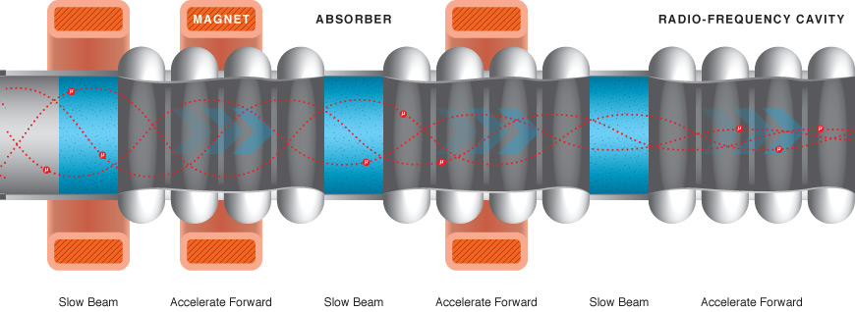
Muon Ionization Cooling
Ionization cooling is the only practical scheme to cool muon beams
High gradient RF cavities compensate for lost longitudinal energy in absorbers
Strong magnetic field to confine muon beams
Design, engineering and construction of a real muon ionization cooling section
Test of each component: development of NC 201-MHz cavity at ∼16 MV/m that can
operate in a few-Tesla solenoidal B field, liquid hydrogen (LH) absorber and SC magnets

Slide 11
NCRF Cavity Requirements at FE
Muon capture, bunching, phase rotation and ionization cooling require
Low frequency normal conducting RF cavities
High RF gradient operation in a few-T to 10 T magnetic fields

Slide 12
NC RF Cavities for Muon Cooling
Muon ionization cooling channel requires high gradient, normal conducting RF cavities operate in a few Tesla magnetic field (∼ 2.5 Tesla for MICE cooling channel) at gradients of ∼16 MV/m at 201 MHz & ∼26 MV/m at 805 MHz
Accomplishments:
Development of RF cavities with the conventional open beam irises terminated by beryllium windows
Development of beryllium windows
Thin and pre-curved beryllium windows for 805 and 201 MHz cavities
Design, fabrication and tests of RF cavities at MuCool Test Area, Fermilab
805 MHz pillbox cavity with re-mountable windows and RF buttons
Box cavity to test magnetic field insulations: ExB effects
HPRF cavities and beam testing
201 MHz cavity with thin and curved beryllium windows (baseline design for MICE cavity)
Experimental RF test programs at MTA, Fermilab
Lab-G superconducting magnet

Slide 13
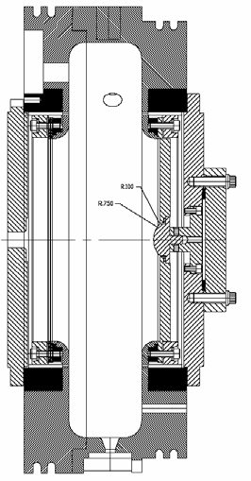
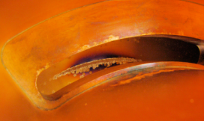
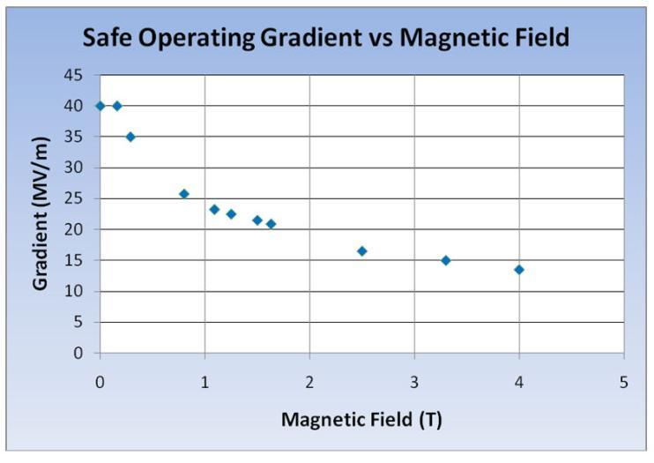
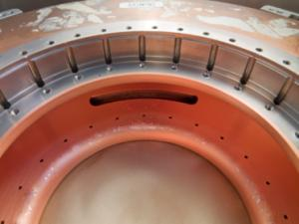
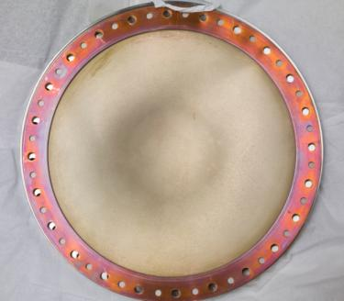
RF Challenges for Muon Ionization Cooling
Experimental studies using 805 MHz pillbox (+ button) cavity
RF gradient degradation in strong magnetic field
Cavity surface damage
No damage on Beryllium window
Coupling iris
805 MHz Cavity
Be window

Slide 14
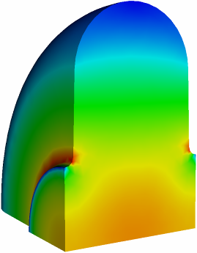
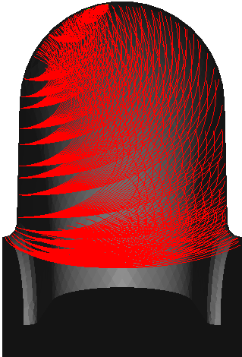
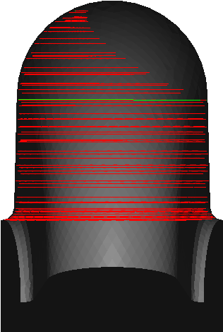
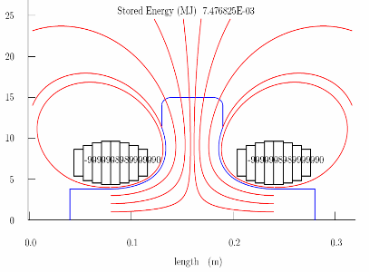
RF Breakdown in a Strong B Field
The RF breakdown could be related by heating through field emission + magnetic field and RF field:
External magnetic field
Ohmic heating
Possible solutions
ExB
Choice of materials
Lower initial temperatures
E field contour
B=0 T
B=1 T
Magnetic insulation

Slide 15
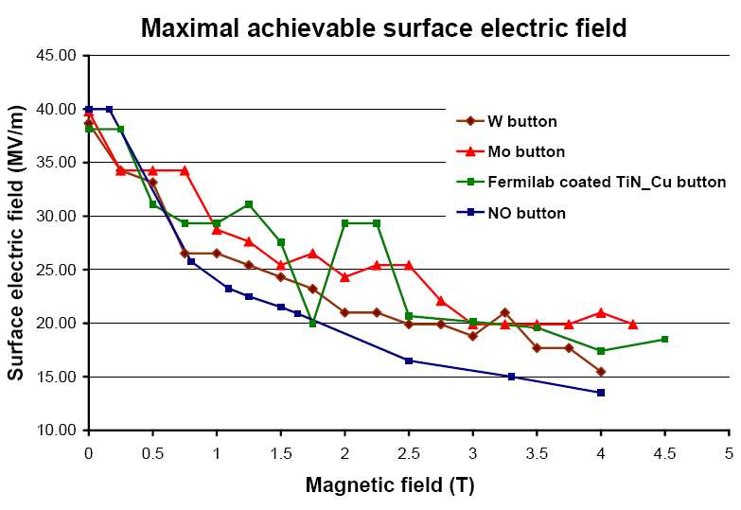
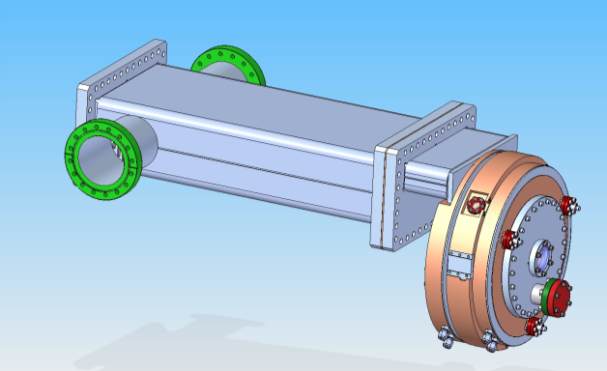
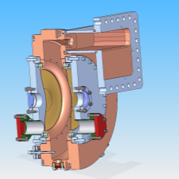
Understanding RF Breakdown in B field and Find Solution to Muon Cooling Ionization Channel
High electrical field → field emission, focused by external magnetic field → surface damage (cavity materials)
Two new cavity designs: low peak surface field at couplers
Low peak surface field (at coupler) cavity design
Modular Be-wall cavity
Single button test results
Coupling from equator, side wall removable
Improved pillbox cavity
design with low peak surface field
Scatter in data may be due to surface damage on
the iris and the coupling slot

Slide 16
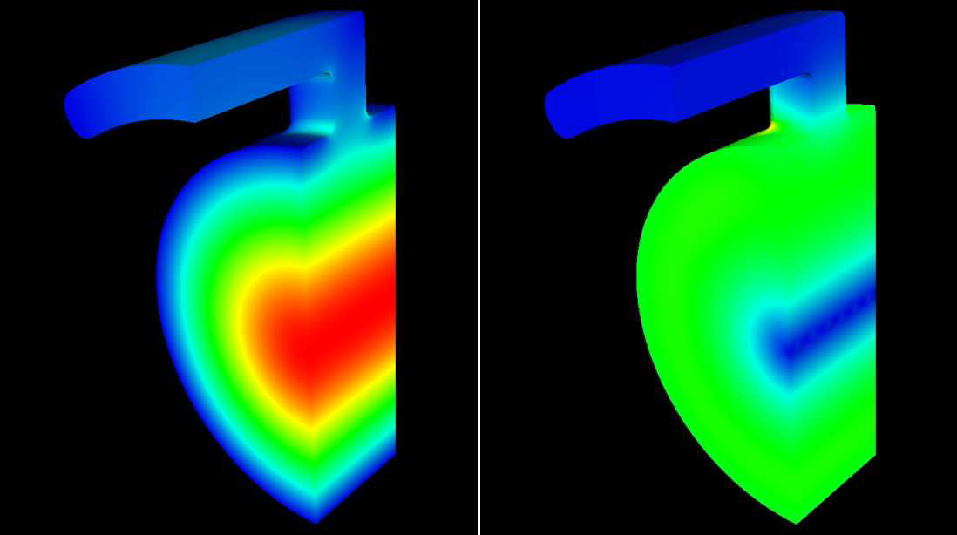
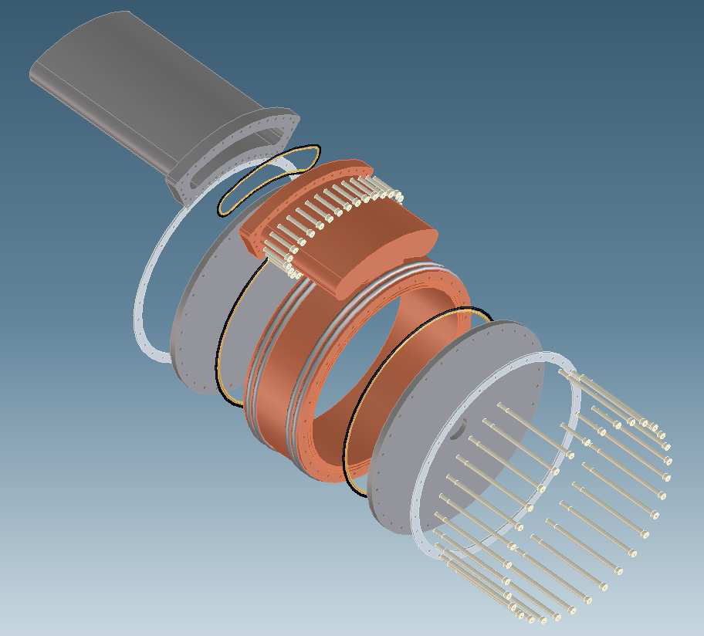
Modular Pillbox Cavities
805 MHz Modular Cavity Design
Coupling from equator: lower E field at coupler
Demountable end-plates allow for testing of different materials and cavity lengths
LBNL and SLAC responsible for the design and fabrication
RF and MP simulations; cavity fabrication will start soon

Slide 17
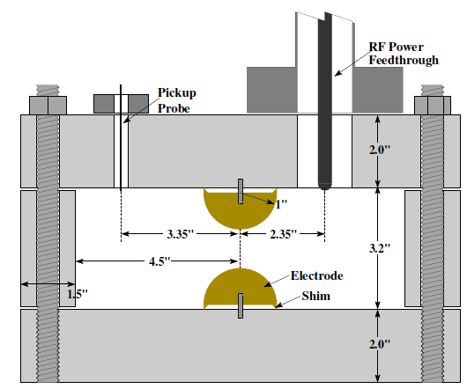
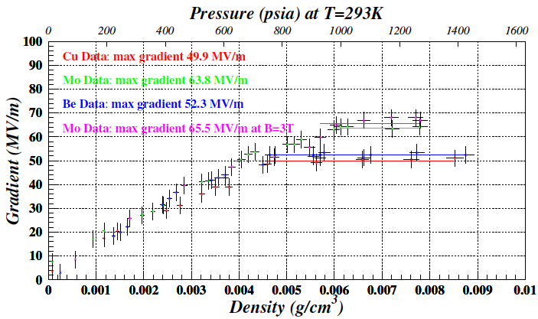
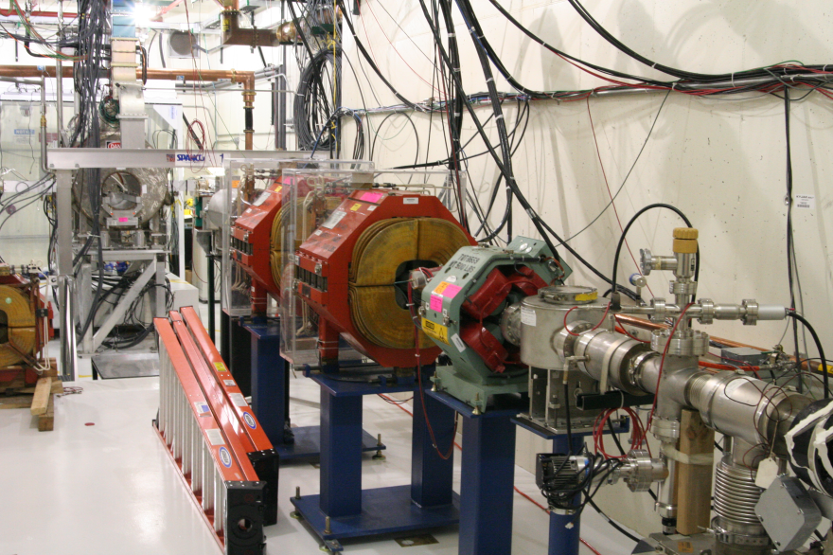
HPRF Cavity Test at 805 MHz
High Pressure RF (HPRF) cavity has been successfully operated in strong magnetic fields
Use Hydrogen gas as ionization cooling material
Maximum electric field gradient in HPRF test cell
Schematic view of HPRF test cell
Metallic breakdown
Operation range for muon cooling
Gas breakdown

Slide 18
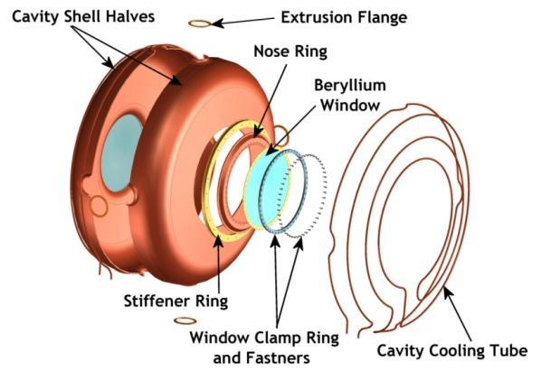
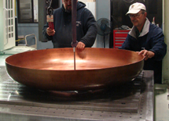
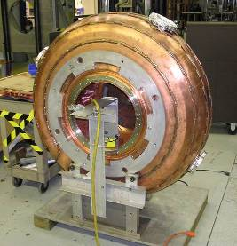
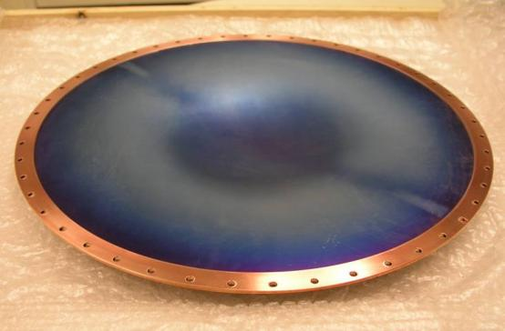
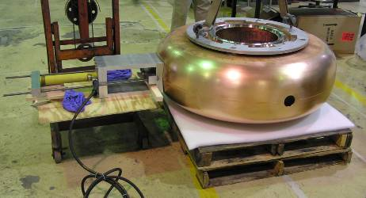
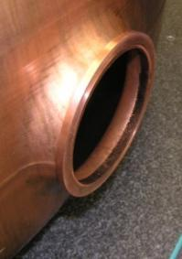
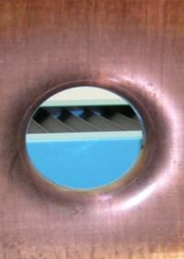
Development of 201-MHz Cavity
Cavity fabrication technique development, in collaboration with JLab; The cavity has been high power tested at MTA, Fermilab
42-cm

Slide 19
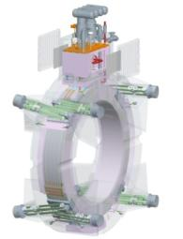
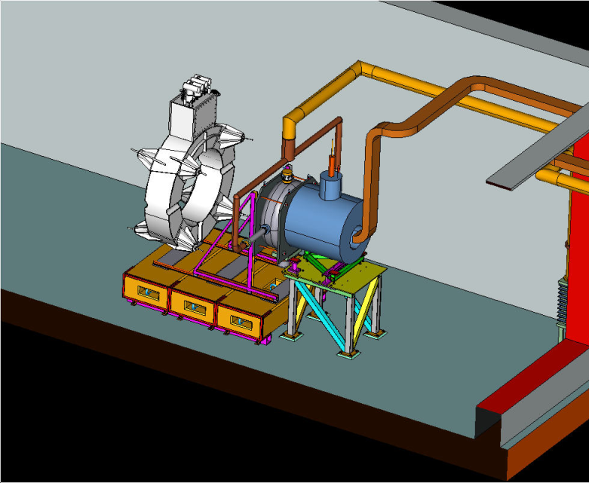
201 MHz Cavity Tests
Reached 19 MV/m w/o B, and 12 MV/m with stray field from Lab-G magnet
SC CC magnet
201-MHz Cavity
Lab G Magnet
MTA RF test stand

Slide 20
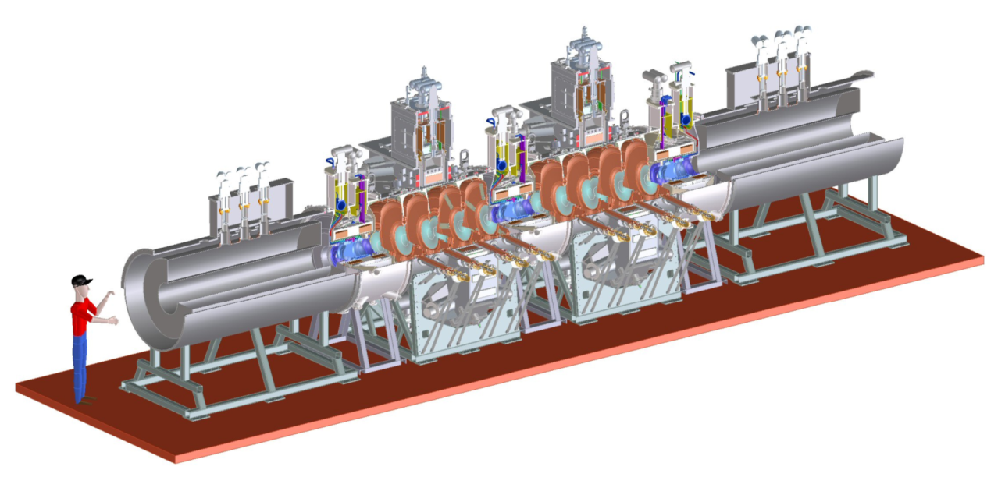
US Responsibilities in MICE
US responsibilities in MICE cooling channel:
Two RFCC modules
Two spectrometer solenoid magnets
RFCC
RFCC
SS
SS
International MICE experiment at RAL
Demonstration of muon ionization cooling

Slide 21
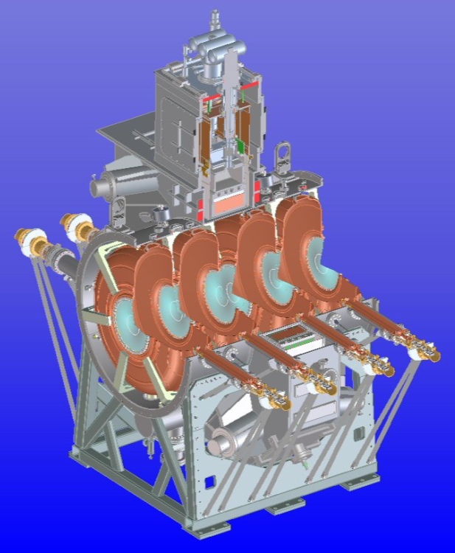
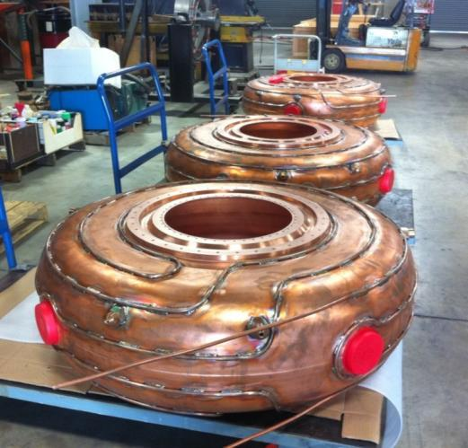
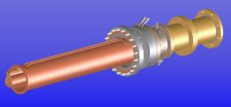
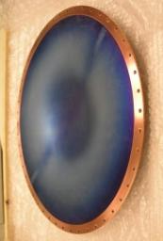
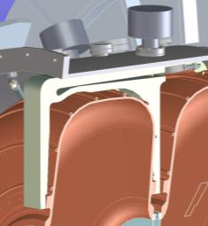
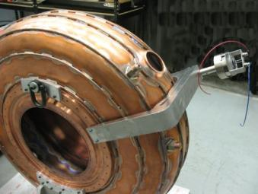
RFCC Module: 201 MHz Cavity
Sectional view
of RFCC module
Cavity fabrication
Coupler
Beryllium window
tuner

Slide 22
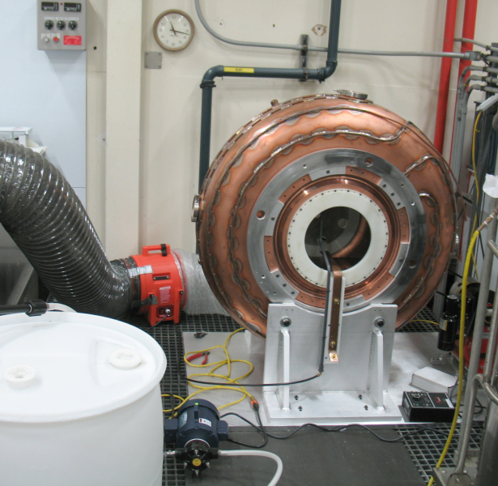
Summary of MICE Cavities
Ten cavities with brazed water cooling pipes (2 spares) complete and are at LBNL now
Five cavities measured
Received 11 beryllium windows
Received 10 ceramic RF windows
Tuner design complete, one tuner prototype tested offline
Six prototype tuners in fabrication, and to be tested soon
Design of RF power (loop) coupler complete, ready for fabrication
Design of cavity support and vacuum vessel complete
Cavity post-processing: one cavity has been EPed recently at LBNL
22

Slide 23
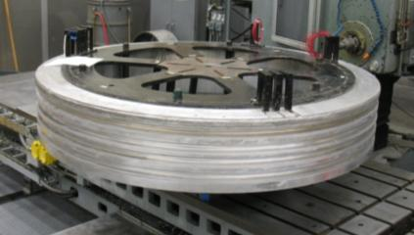
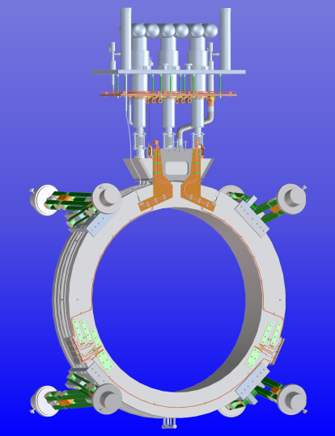
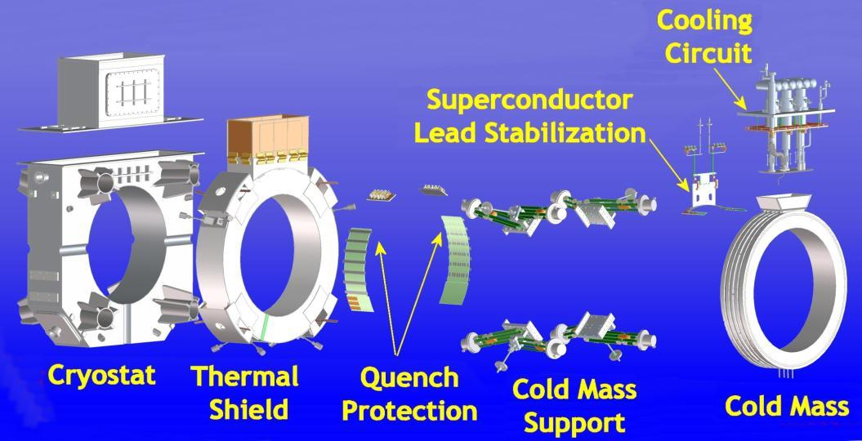
Coupling Coil Magnets
MICE/MuCool CC design and fabrication in collaboration with HIT, China
→ cold-mass fabrication
First cold mass at LBNL, in preparation for testing at Fermilab this summer
Designs of cryostat, cooling circuit, QP, lead stabilization complete, parts in fabrication; SC wires for future coils ordered; LHe pipes welded.
RFCC module
Cryostat
Cold-mass

Slide 24
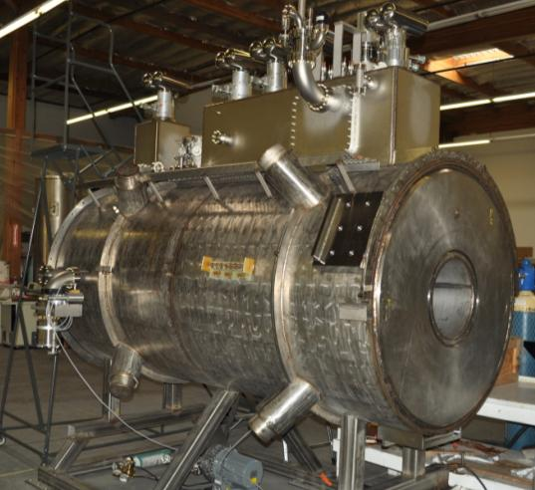
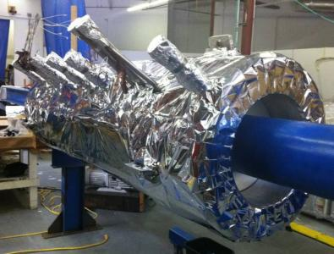
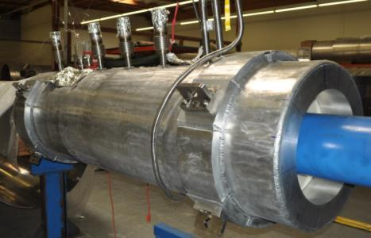
MICE Spectrometer Solenoids
The five coil superconducting Spectrometer Solenoid magnets are being fabricated by a local vendor (Wang NMR) in Livermore, CA with assistance from the LBNL Engineering Division and MICE collaborators. The first rebuilt magnet is being tested now (cold, and waiting for more LHe).
First magnet cold mass
wrapped with MLI
2nd magnet cold
mass in preparation
Notes:
Changed bullets

Slide 25
Summary
Muon collider and Neutrino Factory require normal conducting RF cavity operating at high gradient in a few Tesla magnetic field
Remains a challenge
R&D plans developed under MAP to find a workable solution
Plans for RF breakdown studies
Vacuum cavity
New 805-MHz cavity design, fabrication and testing
Modular beryllium-side-wall cavity
ALD, and other programs
High pressured RF cavity (K. Yonehara’s talk on Thursday)
201-MHz RF cavity for MuCOOL/MICE progressing well
Major hardware responsibilities for MICE
Notes:
Added first words on GAD support

Slide 26
Acknowledgements
Thanks to my colleagues from MAP and MICE Collaborations
Many slides presented here freely taken from the work conducted and presentations by my collaborators in the collaborations
Institutions in MAP Collaboration:
Argonne National Laboratory
Brookhaven National Laboratory
Cornell University
Fermi National Accelerator Laboratory
Illinois Institute of Technology
Jefferson Laboratory
Lawrence Berkeley National Laboratory
Muons Inc.
Oak Ridge National Laboratory
Princeton University
SLAC National Accelerator Laboratory
University of California – Berkeley
University of California – Los Angeles
University of California – Riverside
University of Chicago
University of Mississippi

